Slide 1
ARTIFICAL INTELLIGENCE
PRESENTATION :-
By :-
Gurkirat Singh Toor
Jaskaran Singh
Paras Dupar
Nitin Rana

Slide 2

FLIGHT PRICE PREDICTION
Predicting flight ticket prices using machine learning to help travelers and airlines make better pricing decisions.

Slide 3
INTRODUCTION
Flight price prediction helps forecast ticket fares based on factors like airline, departure time, duration, and demand trends.
Using ML models, we can estimate future flight prices to optimize booking decisions.

Slide 4
OBJECTIVE
• To predict flight ticket prices accurately.
• To help users find the best time to book flights.
• To assist airlines in setting dynamic and competitive prices.

Slide 5
DATASET DESCRIPTION
Dataset contains details such as:
• Airline
• Source and Destination
• Date of Journey
• Duration
• Total Stops
• Price (Target variable)

Slide 6
STEP 1: IMPORTING LIBRARIES
Libraries Used:
• Pandas – Data handling
• NumPy – Numerical operations
• Matplotlib & Seaborn – Data visualization
• Scikit-learn – Machine learning models

Slide 7
STEP 2: EXPLORATORY DATA ANALYSIS (EDA)
• Understand data distribution and structure
• Visualize correlations and trends
• Handle outliers and missing values

Slide 8
STEP 3: DATA CLEANING
• Remove null or duplicate values
• Format date and time columns
• Extract features like hour, day, month from date

Slide 9
STEP 4: FEATURE ENGINEERING
• Convert categorical data into numeric using OneHotEncoding
• Create new features like ‘Journey Day’ or ‘Airline Type’
• Scale data if required

Slide 10
STEP 5: SPLITTING DATA
• Dataset divided into training and testing sets (e.g., 80%-20%)
• Ensures fair model evaluation

Slide 11
LINEAR REGRESSION
A supervised learning algorithm that fits a straight line between features and price.
Helps identify how each variable (like airline or duration) affects price.

Slide 12

RANDOM FOREST REGRESSION
An ensemble method combining multiple decision trees.
Gives robust predictions and reduces overfitting.
Performs well on nonlinear relationships.

Slide 13
MODEL EVALUATION METRICS
Metrics Used:
• Mean Absolute Error (MAE)
• Mean Squared Error (MSE)
• R² Score
Lower MAE and higher R² indicate better model performance.

Slide 14
VISUALIZATION INSIGHTS
• Price increases with longer duration and closer departure date.
• Non-stop flights cost more than connecting ones.
• Certain airlines show higher average fares.

Slide 15
COMPARISON OF MODELS
Linear Regression → Simpler but less accurate.
Random Forest → More accurate, handles complexity well.
Hence, Random Forest chosen for final prediction.

Slide 16
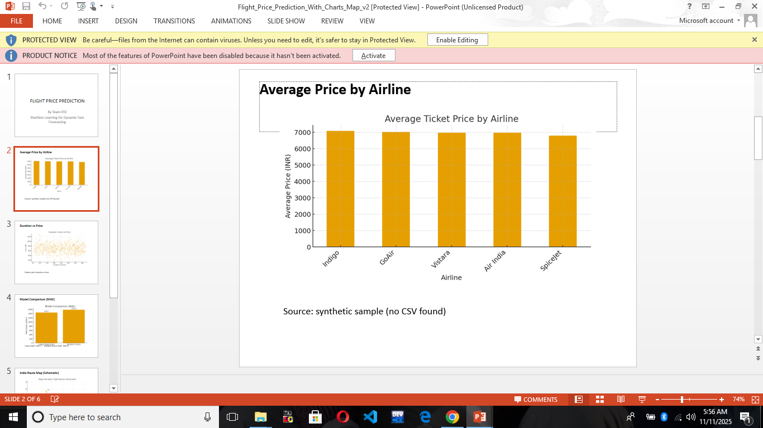
Average price by airline

Slide 17
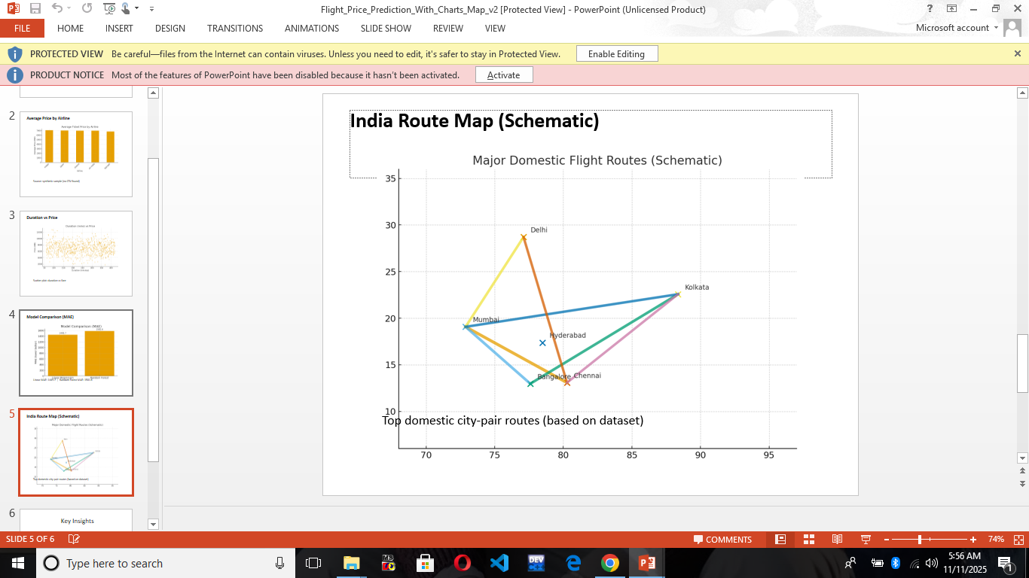
India route map

Slide 18
APPLICATIONS
• Online flight booking platforms for dynamic pricing.
• Airlines for optimizing revenue.
• Travelers to plan trips economically.

Slide 19
FUTURE WORK
• Include real-time price data.
• Use deep learning models (LSTM) for time-series forecasting.
• Build a web or mobile app for public use.

Slide 20
CONCLUSION
Machine learning can accurately predict flight prices.
Helps both travelers and airlines make informed decisions.
Random Forest gives the best accuracy among tested models.

Slide 21
REFERENCES
• Dataset: Kaggle Flight Price Prediction Dataset
• Libraries: Scikit-learn, Pandas, Matplotlib, Seaborn
• Concepts inspired by ML and EDA techniques.

Slide 22

THANK YOU
Questions?

